Slide 1
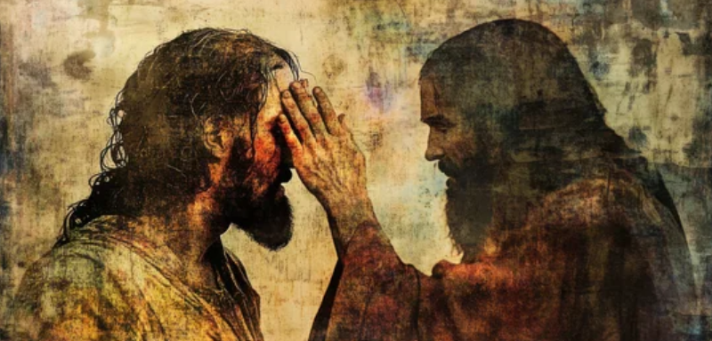
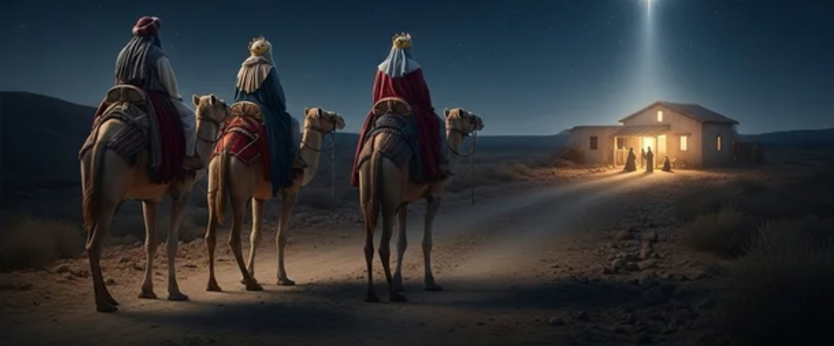
Epiphany: Clues. Dots. & true Light.
Notes:
Understanding Zacchaeus requires insight into his identity, the social role of tax collectors, and the importance of Jericho in biblical history.

Slide 2



Epiphany: Clues. Dots. true Light.
Notes:
Understanding Zacchaeus requires insight into his identity, the social role of tax collectors, and the importance of Jericho in biblical history.

Slide 3

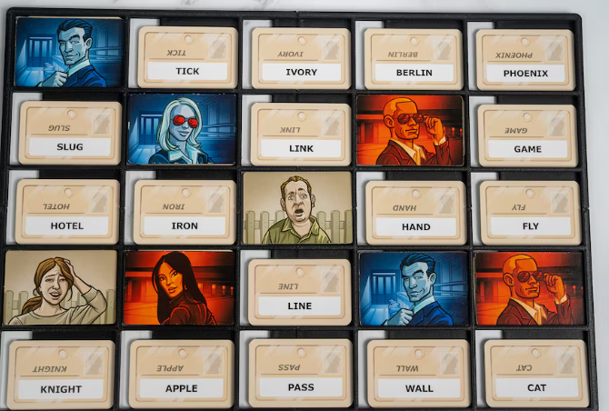
to Seek for the Word!
1. CLUES.
Notes:
Understanding Zacchaeus requires insight into his identity, the social role of tax collectors, and the importance of Jericho in biblical history.

Slide 4
Epiphany: Clues.
Seeking the Truth
that the Clues point to!
Notes:
Understanding Zacchaeus requires insight into his identity, the social role of tax collectors, and the importance of Jericho in biblical history.

Slide 5

to Seek the Word!
QUESTION:
What if, God has given us clues; hoping that we will inquire – or that we will be curious enough to seek.
How far are we willing to go in pursuit for the Truth?
Notes:
Understanding Zacchaeus requires insight into his identity, the social role of tax collectors, and the importance of Jericho in biblical history.

Slide 6
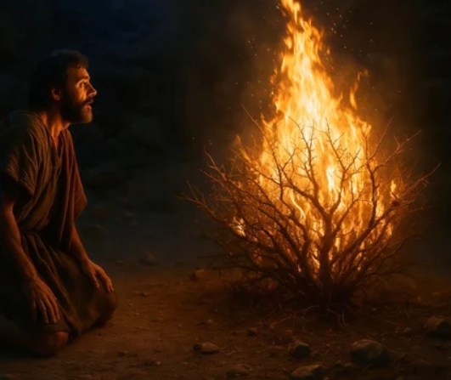
to Uncover the Clues!
The burning bush:
Could the clues be an invitation to come closer?
Moses
Notes:
Understanding Zacchaeus requires insight into his identity, the social role of tax collectors, and the importance of Jericho in biblical history.

Slide 7
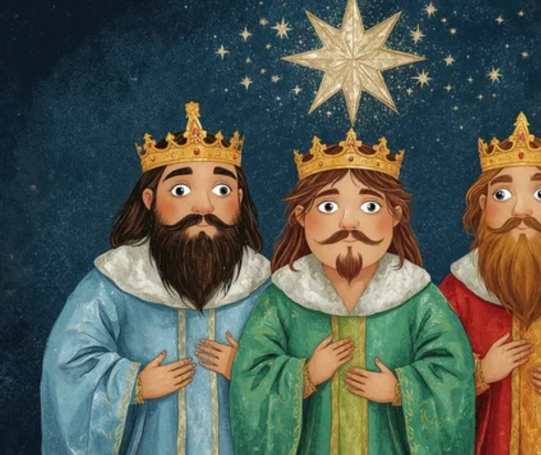
to Uncover the Clues!
the Star:
Could the star ignite our curiosity to seek!
Could EPIPHANY be about realising that there are clues all around us?
Notes:
Understanding Zacchaeus requires insight into his identity, the social role of tax collectors, and the importance of Jericho in biblical history.

Slide 8

to Uncover the Clues!
the Challenge:
Can one have an Epiphany if they are NOT willing to seek/ uncover the clues?
Notes:
Understanding Zacchaeus requires insight into his identity, the social role of tax collectors, and the importance of Jericho in biblical history.

Slide 9


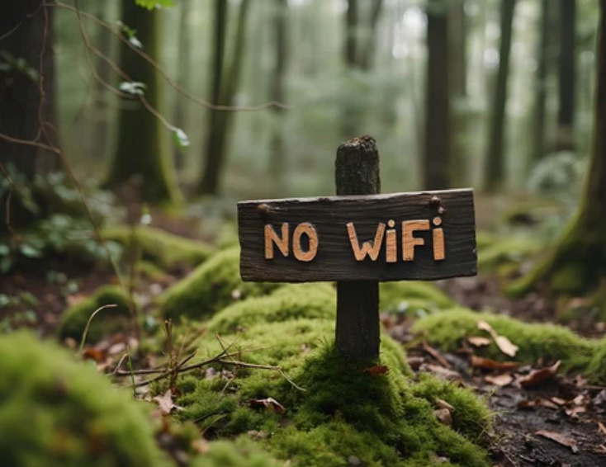
2. DOTS.
to Connect the Dots!
Notes:
Understanding Zacchaeus requires insight into his identity, the social role of tax collectors, and the importance of Jericho in biblical history.

Slide 10

Epiphany: Dots.
Connecting the Dots
that lead us to our Home
Notes:
Understanding Zacchaeus requires insight into his identity, the social role of tax collectors, and the importance of Jericho in biblical history.

Slide 11

to Connect the Dots!
QUESTION:
What if we have seen the star but misconnected the dots – hence ending up in a palace as opposed to His presence.
Are we distracted by those we meet along the way or are we determined to crack on?
Notes:
Understanding Zacchaeus requires insight into his identity, the social role of tax collectors, and the importance of Jericho in biblical history.

Slide 12

to Connect the Dots!
the Challenge:
Are you waiting to have all the answers before getting on your way?
Notes:
Luke 2:16. Matthew 2:11. Acts 9: 1 - 5 Genesis 18: 1

Slide 13

to Connect the Dots!
the Challenge:
Which palaces have we ended up visiting hoping to find the King?
Stadium? Work? Pub?
Notes:
Luke 2:16. Matthew 2:11. Acts 9: 1 - 5 Genesis 18: 1

Slide 14
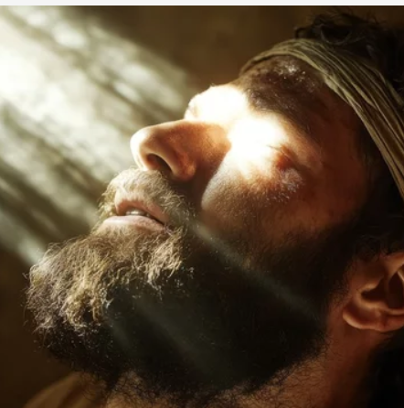
to Connect the Dots!
When you successfully connected the dots, where did you find Him?
Notes:
Luke 2:16. Matthew 2:11. Acts 9: 1 - 5 Genesis 18: 1

Slide 15
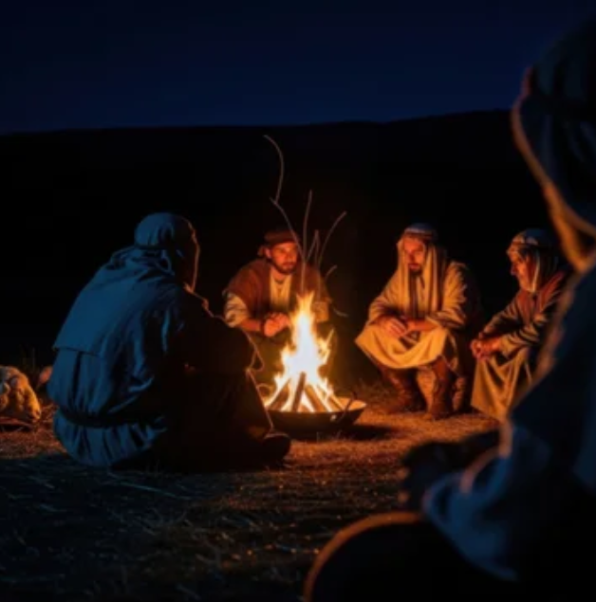
to Connect the Dots!
The Connection!
When you successfully connected the dots, where did you find Him?
Notes:
Luke 2:16. Matthew 2:11. Acts 9: 1 - 5 Genesis 18: 1

Slide 16
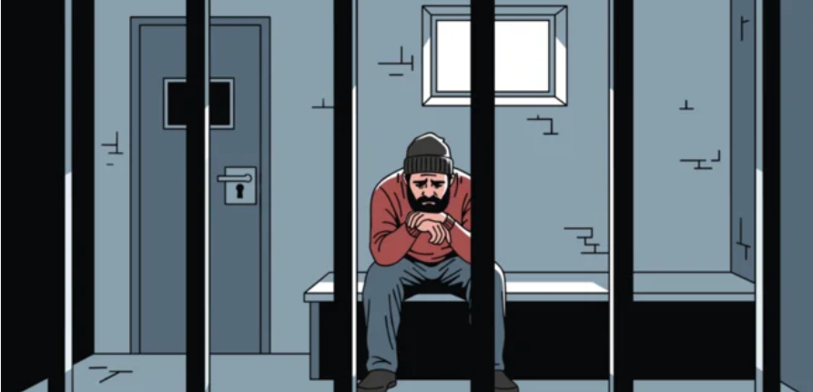
Epiphany: Light.
Those in the Shadow
of death, LIGHT has dawned!
Notes:
Understanding Zacchaeus requires insight into his identity, the social role of tax collectors, and the importance of Jericho in biblical history.

Slide 17
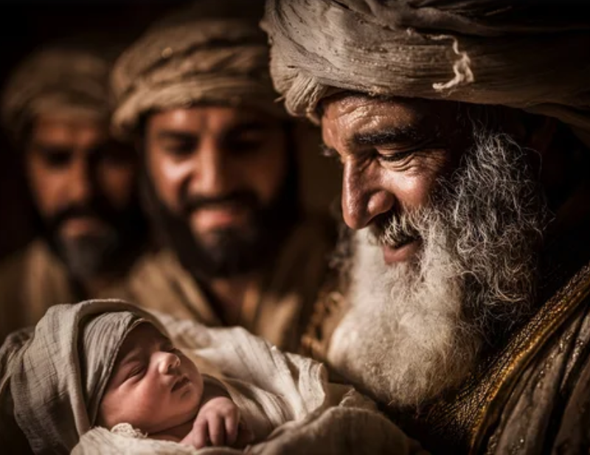

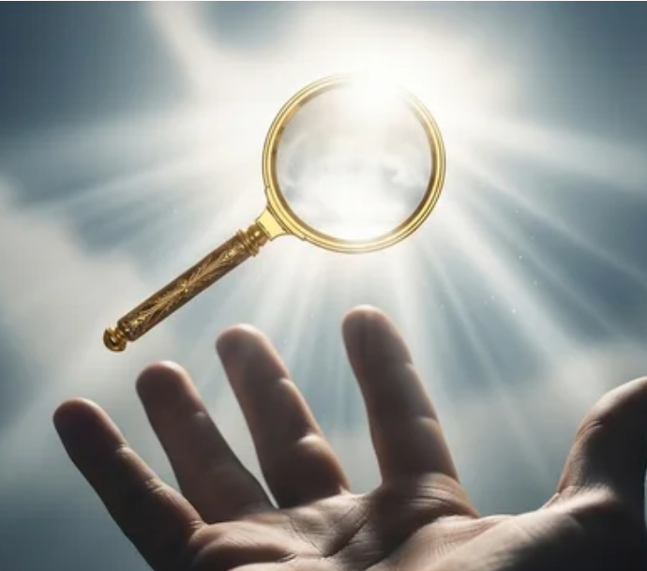
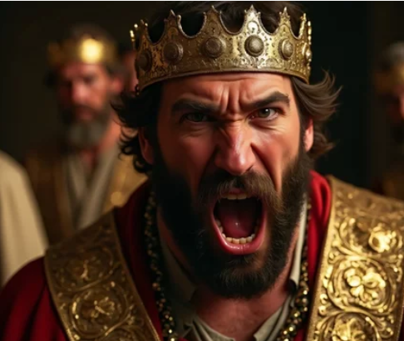
3. LIGHT.
to Reveal the Light!
Notes:
Understanding Zacchaeus requires insight into his identity, the social role of tax collectors, and the importance of Jericho in biblical history.

Slide 18
to Reveal the Light!
QUESTION:
Could revealing the Light also bring enmity because true Light exposes the deeds of darkness.
Notes:
Luke 2:35. Matthew 2:16. John 3:19. 1 Kings 3: 16 - 28

Slide 19

to Reveal the Light!
the Challenge:
What would revealing this Light mean for us today in 2026?
Notes:
Luke 2:35. Matthew 2:16. John 3:19. 1 Kings 3: 16 - 28

Slide 20
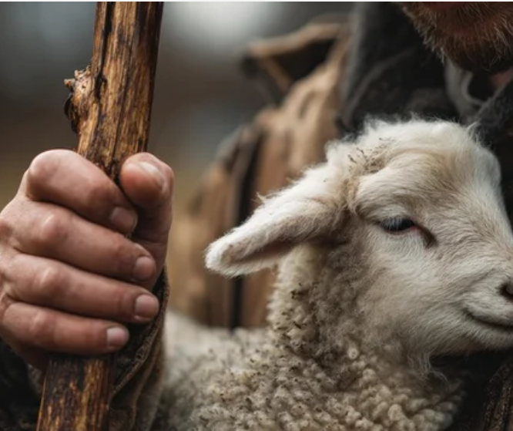
to Reveal the Light!
the Challenge:
Being the Light:
What gifts are we to bring to the King?
Notes:
Luke 2:35. Matthew 2:16. John 3:19. 1 Kings 3: 16 - 28

Slide 21

to Reveal the Light!
the Challenge:
Remaining in the Light:
How can we stay children of LIGHT?
Notes:
Luke 2:35. Matthew 2:16. John 3:19. 1 Kings 3: 16 - 28

Slide 22
Epiphany: Clues. Dots. & true Light.
Notes:
Understanding Zacchaeus requires insight into his identity, the social role of tax collectors, and the importance of Jericho in biblical history.

